Slide 1



Presentation on
TRAINING MANAGEMENT SOFTWARE
WELCOME BIMAN BANGLADESH AIRLINES

Slide 2

ABOUT
COMPANY
About Bizz Solutions PLC
Bizz Solutions PLC is a leading software development company delivering reliable and scalable solutions across Web, Desktop (PC), and Mobile platforms. Our core focus is on building user-friendly, meaningful digital experiences while ensuring the highest level of customer satisfaction.
With over 8 years of proven experience in IT services, we have successfully developed custom software applications and mobile apps for clients across the globe. Since our establishment in 2018, Bizz Solutions PLC has consistently pushed technological boundaries to deliver innovative, secure, and future-ready digital solutions tailored to diverse business needs.
In recognition of our excellence and contribution to the technology sector, Bizz Solutions PLC was honored with the President’s Award for Industrial Development 2021 (High-Tech Industry Category)—a testament to our commitment to innovation, quality, and national economic growth.

Slide 3
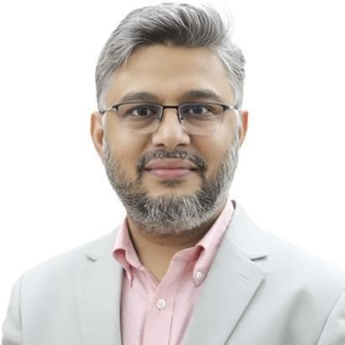
HONORABLE CHAIRMAN OF
BIZZ SOLUTIONS PLC
Md. Shafiqul Alam, LL.B, FCS, FCMA, FCA
ERP Consultant | Finance & Business Strategy Expert and Education Expert
• Over 19 years of experience across power, pharmaceuticals, manufacturing, ICT, insurance, and public sector organizations. • Specialist in SAP-based ERP implementation, financial restructuring, corporate governance, SOP and policy development, and enterprise transformation. • ERP Consultant at Bangladesh-China Power Company Ltd. (BCPCL) and Managing Partner & CEO of Shafiqul Alam & Co., Chartered Accountants (serving 50+ organizations). • Finance Director, Bangladesh Rural Development Board (BRDB) – Rural electricity and development services (Ongoing). • Finance Director, Jibon Bima Corporation – Life insurance and reinsurance operations (Ongoing). • Elected Member, Institute of Chartered Accountants of Bangladesh (ICAB) – Policy formulation and strategic direction. • Chairman, Bizz Solutions PLC (BASIS-accredited ICT firm) – SAP licensing and enterprise automation initiatives. • Recipient of Chief Financial Officer of the Year (World HRD Congress, 2017) and President’s Award for Industrial Development 2021 (High-Tech Industry Category).

Slide 4




Our Concern

Slide 5
TRAINING MANAGEMENT
SYSTEM
Questions Bank
Exam
Questions Sections
Front end : React Js
Back end : Laravel
Exam Schedule
Participation

Slide 6






LIST OF CLIENTS WE'VE
SUCCESSFULLY WORKED ON IN THE PAST
www.rmgroup-bd.com
www.sslcommerz.com
www.ssgbd.com
www.saco.com.bd
www.cafsedu.org
www.edubd.tv

Slide 7


Thank You
For Your Attention
Visit Our Website
www.bizzsol.com.bd

